Slide 1



ACT in College Settings
Jacqueline Pistorello, Ph.D.
University of Nevada, Reno

Slide 2

A few collaborators:
Steven C. Hayes, Ph.D., UNR
John Seeley, Ph.D., Oregon Research Institute
Michael Levin, M.A., UNR
Tony Biglan, Ph.D., Oregon Research Institute
Doug Long, M.A., UNR
Jason Lillis, Ph.D., UNR (now Brown U)
Jennifer Villatte, M.A., UNR (now UW)
Chelsea MacLane, Ph.D., UNR (now in private practice in OR)
Marcia Cooper, LCSW, UNR
Brandon Sanford, UNR
And many others…
Some projects discussed were funded by grants from the National Institute of Mental Health (NIMH) and the National Center for Complementary and Alternative Medicine (NCCAM)

Slide 3
You should be able to:
Know some stats about college students
Describe 2-3 ways to implement ACT interventions with college students/campuses
Apply knowledge of 2-3 challenges (and solutions) to using ACT in college settings
Know where to go for further help when trying to apply this knowledge
Notes:
Intervention – prevention, outreach, and treatment.

Slide 4
College/Uni
Pair up with someone
What feelings did you notice?
What mattered most to you in college?
What, if anything, surprised you about your reactions?
How might things be different today for the typical college student?
Notes:
Mindfulness – close eyes… imagine back when you were in college/uni… see if you can picture yourself, what you looked like, what you might be wearing…where were you living at the time?... Can you picture walking on campus or into a building on campus… walking into a classroom…talking to other students….taking an exam… going to parties… what was that like?Striking up a conversation with someone new?...What about talking to your parents about college. Now, notice if you can find a feeling of excitement or pride … what mattered most to you about being in college/uni? What about feelings of fear or dread? …Now, pair up with someone next to you and share about your experiences…

Slide 5

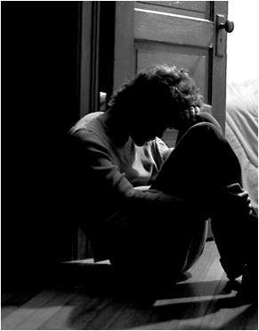
Why bother with college students?
Notes:
Intervention – prevention, outreach, and treatment.
42% of the US population will “touch” college somewhere, sometime.

Slide 6
“I was watching my parents climb into their cars and drive off. As they turned the bend and disappeared…the frost re-formed in my sternum. My mind befogged, my vision began to shimmer, my limbs began to tingle, and I was suddenly seized by the impulse—an impulse it took every bit of self-respect I could muster to stop myself from acting on—to go bolting down the road after them, an idiot dog chasing a car.” Daniel Smith, Monkey Mind, p. 85

Slide 7
Some College Students Suffer…
A Lot
In the previous 12 months, in the US:
50% feel overwhelming anxiety
31% so depressed that it is difficult to function
30-45% engage in binge drinking
50% diagnosable with a mental health disorder
7% Seriously consider suicide
6-7% Engage in non-suicidal self-injury (NSSI)
1.2% Attempt suicide
Suicide second leading cause of death
1,100 or (7.5 per 100,000) commit suicide every year
Notes:
American College Health Association (ACHA, 2012). ACHA-National College Health Assessment II: Reference group executive summary Spring 2012. Hanover MD: American College Health Association.
Whitlock, J., Muehlenkamp, J., Purington, A., Eckenrode, J., Barreira, P., Baral Abrams, G., & ... Knox, K. (2011). Nonsuicidal Self-injury in a College Population: General Trends and Sex Differences. Journal Of American College Health, 59(8), 691-698. doi:10.1080/07448481.2010.529626

Slide 8

Not all students are distressed of course
Of all students:
6% show signs of high psychological distress
35% show some distress
20% Thriving
59% show no distress
Whitlock, et. al., 2011 and in prep
Notes:
Whitlock, J.L. (in preparation). Mental health trajectories and psychological and social antecedents: The role of
emotion regulation, social connection, and meaning.
Note: many resources go for the 6-15% that need it – need a paradigm shift (see article)

Slide 9

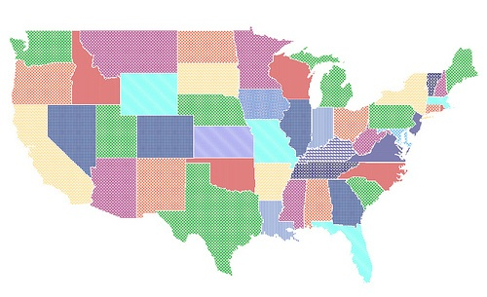
Is it just in the U.S.?

Slide 10
Psychological distress in
Australian college students
Of all students:
AU: 9% Languashing
6% show signs of high psychological distress
35% show some distress
AU: 36%
Flourishing
20% Thriving
59% show no distress
Australian Data from Dr. Phil Renner, University of Sydney. American: Whitlock, et. al., in prep
Notes:
Data from U of Sydney provided through personal communication from Dr. Phil Renner philomena.renner@sydney.edu.au

Slide 11

Prior psych history”
New freedom
College should be “the time of your life”
Physiological changes/hormones
Access to MH resources stigmatized
Emerging adulthood
Sexual exploration and
identity
Social isolation as a result of transition from home to school
High perceived stakes of
failure and success
Changing cultural norms
High number of novel challenges (e.g. financial, interpersonal etc..)
Exposure to
Different ways of thinking, diversity
Increased complexity of developmental tasks
Graph adapted from Whitlock, 2012

Slide 12

Why ACT with College Students?
Experiential avoidance/psychological flexibility associated with retention
Values training increases retention and GPA
Transdiagnostic approach
Great scope: Human condition
Current societal context

Slide 13
How Has ACT Been Utilized with
College Students?
Traditional Psychotherapy
Individual and group therapy
Specific Presentations
Perfectionism
Anxiety/Depression comb.
Substance abuse
Classes
ACT First Year Experience
Infusion of ACT into existing classes
One-time ACT workshops
Web-based Prevention
ACT podcasts to all students
Values training added to goal setting
Universal prevention
Web-based Treatment
Guided Self-Help at Counseling Centers
Outreach
Peer Mentoring
“Dear Jacque”

Slide 14
How Has ACT Been Utilized with
College Students?
Traditional Psychotherapy
Individual and group therapy
Specific Presentations
Perfectionism
Anxiety/Depression comb.
Substance abuse
Classes
ACT First Year Experience
Infusion of ACT into existing classes
One-time ACT workshops
Web-based Prevention
ACT podcasts to all students
Values training added to goal setting
Universal prevention
Web-based Treatment
Guided Self-Help at Counseling Centers
Outreach
Peer Mentoring
“Dear Jacque”

Slide 15
Treatment: ACT Groups
Homogeneous vs. heterogeneous?
Existing protocols
How to select folks?
Two facilitators
Prime student for ACT during intake
Issues that may come up on a college campus
Mindfulness

Slide 16
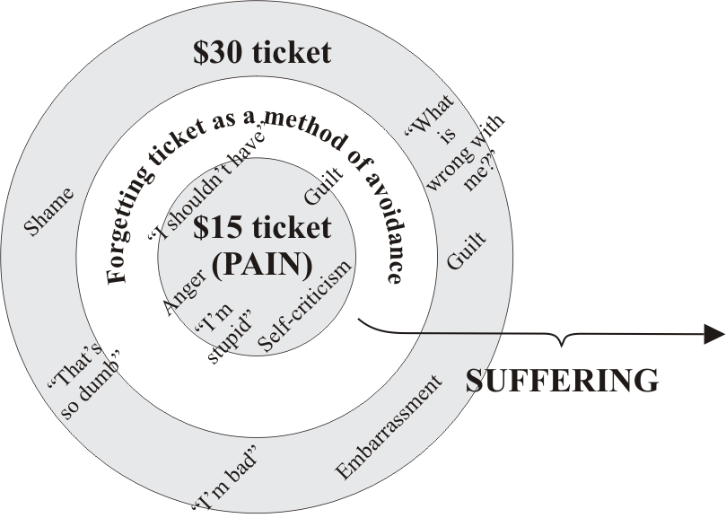
One Way to Get Things Started
Pain vs. Suffering
Notes:
For heterogeneous groups, pain vs. suffering is a way of getting things started

Slide 17
Groups at U of Nevada What Liked About Group?
Interactions with other students
Eyes on exercise
Big Look very powerful
Relating emotionally not intellectually
Comments by others (about themselves and me) helpful
Seeing others’ inner world
Reminders not to try to get rid of pain as goal
Facilitators were authentic and part of the group
Metaphors, guided imagery
Commitment by group participants very high
Being pushed “lightly”

Slide 18
ACT as a First Year Experience
Small classes: 9-15 students each
16 hours total: 8 classes of 2 hours each
Inclusion Criteria for Students:
  Admitted freshmen to U of Nevada, Reno
  17-20
  Answered a brief screening: AAQ-II
Content:
  ACT: Get Out of Your Mind as Textbook
  Psychodidactic: More Typical First Year Experience
Notes:
Pistorello, J., Hayes, S. C., Lillis, J., Long, D., Christodoulou, V., LeJeune, J., et al., (2013). Acceptance and Commitment Therapy (ACT) in classroom settings. In J. Pistorello (Ed.), Mindfulness and acceptance for counseling college students: Theory and practical applications for intervention, prevention, and outreach. Oakland, CA: New Harbinger.

Slide 19
A Randomized Controlled Trial
Notes:
Explain…
Screening … selected students based on psychological flexibility… those lower invited first…
will follow students for 3 years. Don’t have data yet on impact on mental health and grades, but will start second year follow up this fall.
State age… 85% 18 years old, 35% male, 25% met a current diagnosis, but bulk of students in non-clinical range (BDI mean = 8)

Slide 20
How Do We Adapt ACT to a Classroom Format with Students Not Currently Distressed?
Lots of visual aids (youtube videos, etc)
Make it “fun” as much as possible
Less “doom and gloom”
More didactic but still interactive
Light on workability… “watch and see…” or “how has that worked for others in your life?”
How to address prevention?

Slide 21
An Example of an ACT Exercise
http://www.youtube.com/watch?v=KHi2dxSf9hw
Notes:
Exercise from Pistorello, J., Hayes, S. C., Lillis, J., Long, D., Christodoulou, V., LeJeune, J., et al., (2013). Acceptance and Commitment Therapy (ACT) in classroom settings. In J. Pistorello (Ed.), Mindfulness and acceptance for counseling college students: Theory and practical applications for intervention, prevention, and outreach. Oakland, CA: New Harbinger.

Slide 22
Processing the Video
Pair up with someone
What are some of the judgments that showed up about the adults?
What did the children represent?
If one of these kids were in front of you now, what would you say/do that is in accordance with your values?

Slide 23
Is an ACT Class Acceptable to College Students?
Yes, mostly around 4 on scale of 0-5
No differences between ACT and psychodidactic class in satisfaction or drop out
No adverse events of any sort in ACT

Slide 24
Class Evaluations: Most Impactful
Mindfulness (Noticing exercises)
Bus metaphor and getting to know one’s passengers
Leaves on a stream and learning to “let thoughts go by”
Eyes on exercise
Taking your mind for a walk

Slide 25
ACT Class: Who Likes it Best?
More Distressed or Less Distressed?

Slide 26
Class satisfaction: More Distressed Students Like ACT Better
Student Evaluation of Educational Quality (SEEQ) total (up is good)
Psych Distress *cond: p = .01
General Health Questionnaire (GHQ) quartiles (up is bad)

Slide 27
Student Support Network (SSN)
Peer Mentoring
  Charles Morse, Worcester Polytechnic Institute
  6 sessions, 1 hour each
  ACT Light: ubiquity of human suffering, modeling psychological flexibility, acceptance, valued-based actions, backpack metaphor, perspective taking
  Other: Rogerian stuff – listening & validation
  See Morse, 2013 Reference below
Notes:
Reference: Morse, C. (2013). Teaching mindfulness and acceptance within college communities to enhance peer support. In J. Pistorello (Ed.), Mindfulness and acceptance for counseling college students: Theory and practical applications for intervention, prevention, and outreach. Oakland, CA: New Harbinger.

Slide 28
ACT on College Life:
A Guided Self-Help Program for College Counseling Centers
Michael Levin, Jacqueline Pistorello,
Steven C. Hayes, John Seeley, & Crissa Levin
This research was supported by two Phase I Small Business Innovation Research grants from the National Institute of Mental Health, R43MH085336 (PIs: Levin, Pistorello, & Hayes) awarded to Contextual Change LLC

Slide 29
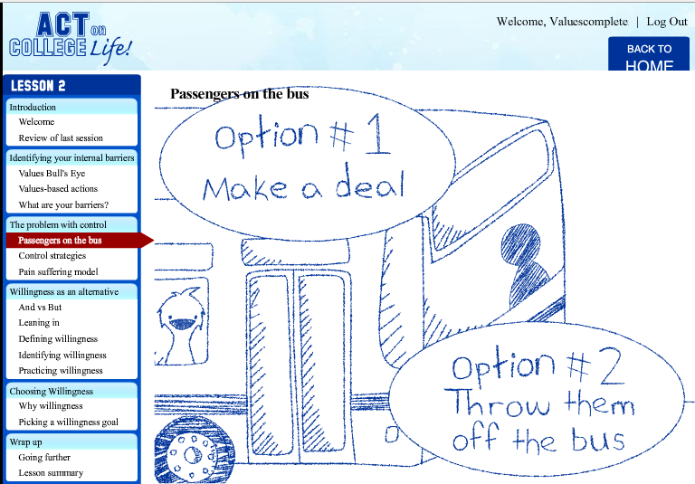
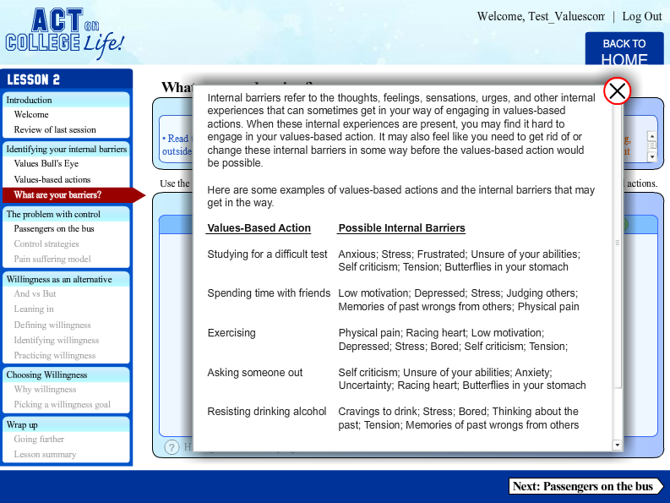
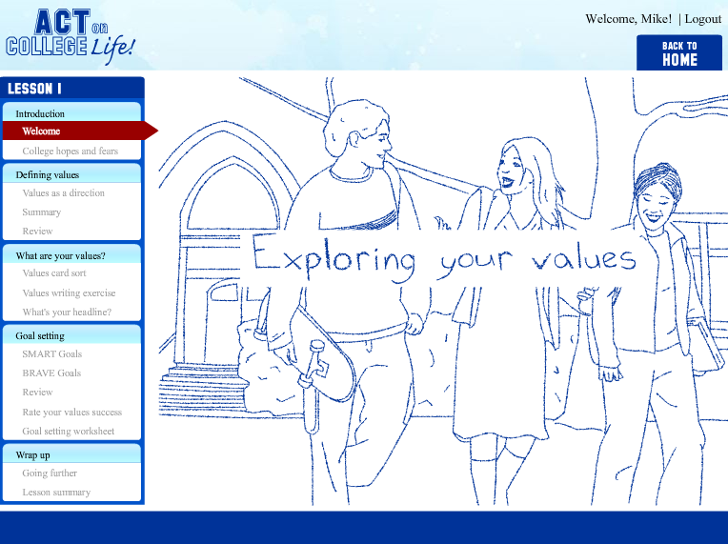
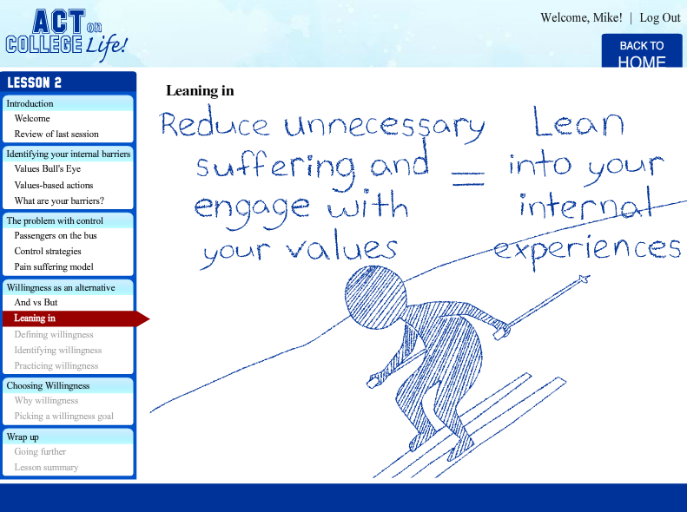
Self-Help Modules: Multimedia
Notes:
Heavy use of audio narration with supplementing text (tried to avoid text heavy pages)
Tried to keep audio as short and clear as possible (which can be challenging)
Animations to illustrate ACT metaphors
Sought for simple, but appealing animation style for students
Animations targeted to college students such as in this example where drawings of students are provided in the background to coincide with text and audio narration introducing the lesson
Optional popup windows and rollover features were used throughout the program so that users can learn more about a concept or receive further clarification on an exercise, while avoiding excessive information for users who do not require such information. In this example from lesson 2, users can click on “Having trouble identifying internal barriers” to see a number of examples of the types of internal barriers that sometimes get in the way of values-based actions. This information can be instrumental for users in creating their own list of internal barriers.

Slide 30
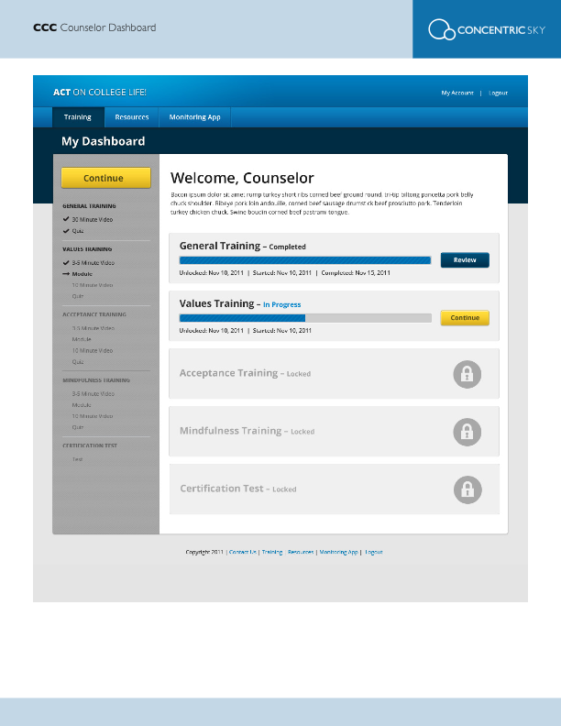
Counselor Dashboard: Training

Slide 31

Counselor Dashboard: Clients

Slide 32

Resources
New Harbinger Website (for free access to Appendix materials)
Feel free to contact me:
Jacqueline.Pistorello@gmail.com

Slide 33
References
American College Health Association (ACHA, 2012). ACHA-National College Health Assessment II: Reference group executive summary Spring 2011. Hanover MD: American College Health Association.
Blanco, C., Okuda, M., Wright, C., Hasin, D.S., Grant, B.F., et al. (2008). Mental health of college students and their non-college-attending peers: Results from the national epidemiologic study on alcohol related conditions. Archives of General Psychiatry, 65, 1429-1437.
Center for Collegiate Mental Health (2013). 2012 Annual Report (Publication No. STA 13-68).
Gallagher, R. (2013). National Survey of College Counseling 2012, Monograph Series Number 9T. Pittsburgh, PA: The International Association of Counseling Services, Inc.
Hayes, S.C., Pistorello, J., Levin, M. (2013) Mindfulness and acceptance in college students: Why it matters. In J. Pistorello (Ed.), Mindfulness and acceptance for counseling college students: Theory and practical applications for intervention, prevention, and outreach. Oakland, CA: New Harbinger.
Morse, C. (2013). Teaching mindfulness and acceptance within college communities to enhance peer support. In J. Pistorello (Ed.), Mindfulness and acceptance for counseling college students: Theory and practical applications for intervention, prevention, and outreach. Oakland, CA: New Harbinger.
Pistorello, J., Hayes, S. C., Lillis, J., Long, D., Christodoulou, V., LeJeune, J., et al., (2013). Acceptance and Commitment Therapy (ACT) in classroom settings. In J. Pistorello (Ed.), Mindfulness and acceptance for counseling college students: Theory and practical applications for intervention, prevention, and outreach. Oakland, CA: New Harbinger.

Slide 34
References Continued
Silverman, M. M., Meyer, P. M., Sloan, F., et al. (1997).The big ten student suicide study: A 10-year study of suicides on midwestern university campuses. Suicide and Life-Threatening Behavior, 27, 285–303.
Whitlock, J., Muehlenkamp, J., Purington, A., Eckenrode, J., Barreira, P., Baral Abrams, G., & ... Knox, K. (2011). Nonsuicidal Self-injury in a College Population: General Trends and Sex Differences. Journal Of American College Health, 59(8), 691-698.
Whitlock, J.L. (in preparation). Mental health trajectories and psychological and social antecedents: The role of emotion regulation, social connection, and meaning.

